Slide 1
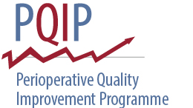
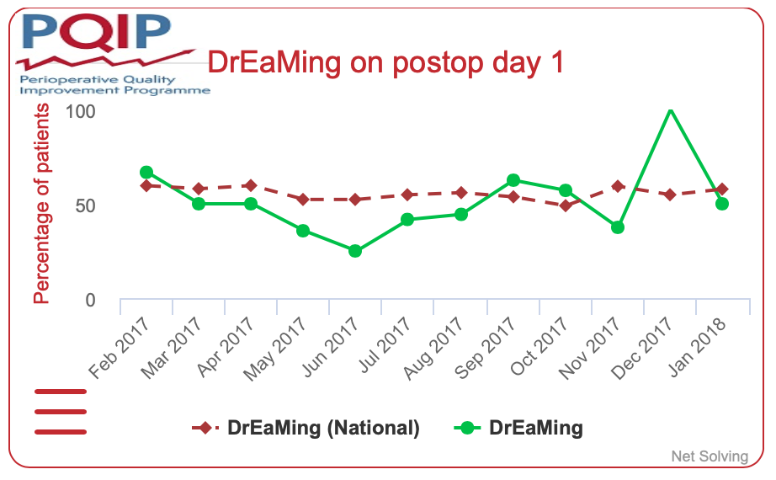
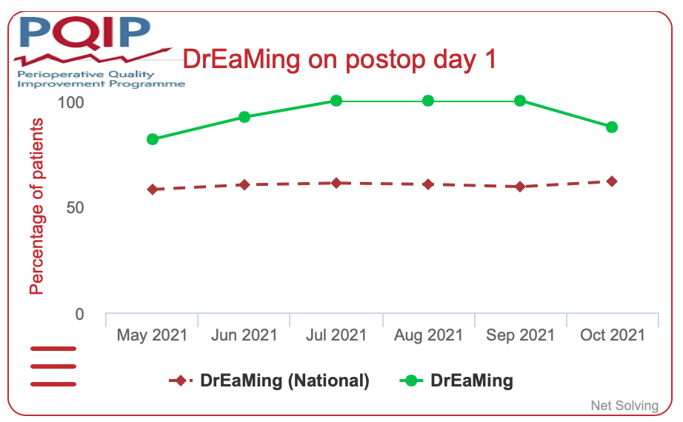
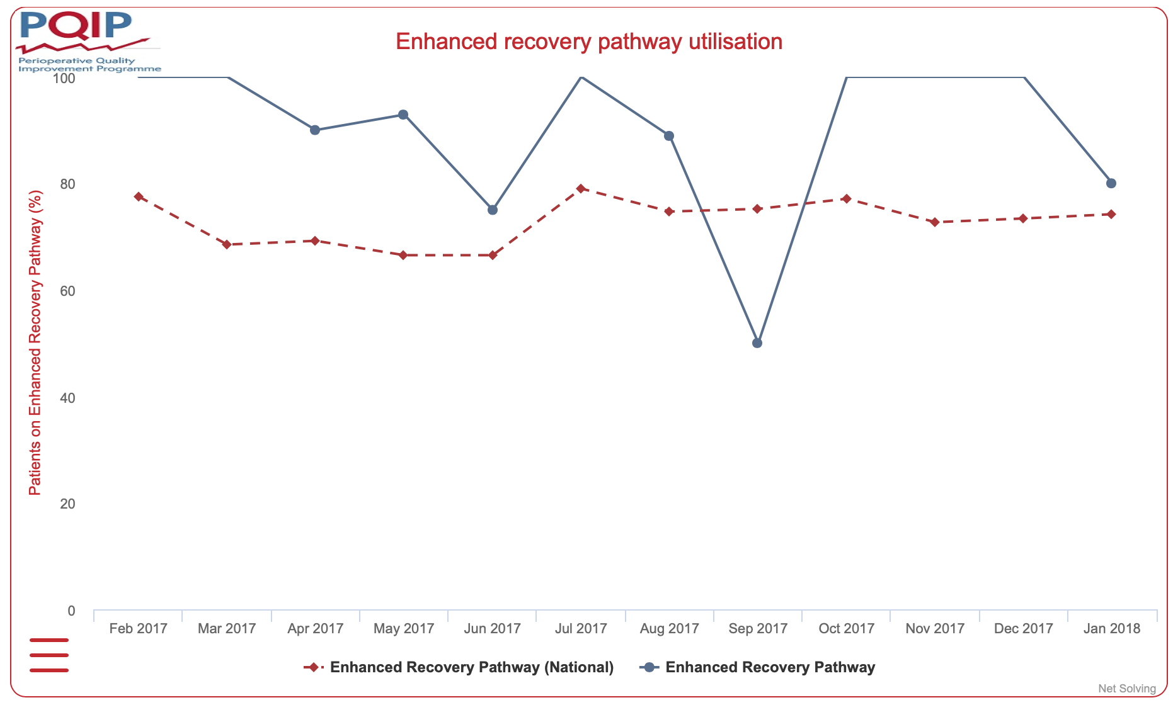
PERIOPERATIVE MANAGEMENT OF COLORECTAL SURGICAL PATIENTS IN YORK HOSPITAL
HETTY NIBLETT
INTRODUCTION
RESULTS
The perioperative quality improvement programme (PQIP) was established in 2016, it recruits patients across the UK to help collect perioperative data for major inpatient non-cardiac surgery throughout the NHS, with the aim of improving perioperative care nationwide (PQIP, 2016). This poster looks at the research, and explains the underlying reasons behind York’s performance in an area of PQIP called DrEaMing – the number of patients drinking, eating, and mobilising in the 24 hours after surgery.
In 2017 the average percentage of patients DrEaMing by the end of day 1 postoperatively was 51.72%, compared to the national average of 55.60%. In the most recent data from May 2021 to October 2021, the average percentage of patients in York that are DrEaMing by the end of day 1 postoperatively increased to 93.60% compared with the national average of 59.40% (PQIP, 2016).
Figure 2:
The percentage of patients DrEaMing in York compared to the national average in February 2017 – January 2018.
Figure 3:
The percentage of patients DrEaMing in York compared to the national average in May 2021 – October 2021. This shows a large improvement in York’s results.
METHODS
CONCLUSIONS
PQIP is based around implementing Enhanced Recovery After Surgery (ERAS) guidelines – a perioperative care pathway designed to achieve early recovery for patients undergoing major surgery. Key factors keeping patients in the hospital after surgery include the need for parenteral analgesia, intravenous fluids, and bed rest caused by lack of mobility. The ERAS pathway addresses these factors with evidence-based practices to improve patient recovery (ERAS, 2021), DrEaMing within 24 hours postoperatively is one of these practices.
Data from October 2021 shows that 87.5% of patients in York undergoing colorectal surgery were placed on an ERAS pathway by month of surgery, well above the national average of 48.4% in the same month (PQIP, 2016).
Under the York perioperative service, a nurse enhanced unit (NEU) was created on the surgical ward in 2016. Here, all patients are reviewed daily by consultant anaesthetists and perioperative nurse specialists, medications and pain control are reviewed and optimised. Excess fluids can also be stopped to reduce overhydration of patients and putting bowel anastomosis at risk.
The perioperative nurses support, train, and empower ward nurses to provide protocolised care with regards to fluid and vasopressor management, and the use of invasive arterial monitoring that was previously only seen in critical care. When patients are nursed on the NEU, staff are so used to the principles of ERAS, the patients are up, dressed, and DrEaMing on day 1, meaning patients benefit from higher dependency care, whilst also receiving enhanced recovery. The research shows this greatly improves patient outcomes, therefore it would be beneficial for other trusts to implement this model of care. Other contributing factors include improved postoperative pain control and improving laparoscopic rates.
The importance of DrEaMing (Gustafsson U.O. et al., 2018):
A delay in the resumption of a normal oral diet after major surgery is associated with increased rates of infectious complications and delayed recovery
Prolonged immobilisation is associated with increased risk of pulmonary complications, decreased skeletal muscle strength, and venous thromboembolism
Figure 1:
Shows the percentage of patients placed on an ERAS pathway by month of surgery – consistently above national average since recruitment to PQIP in 2017.
References:
Perioperative Quality Improvement Programme. [Internet]. 2016 [Cited: 2021 November 13]. Available from: https://pqip.org.uk/Content/home.
Enhanced Recovery After Surgery Society. [Internet]. 2021 [Cited: 2021 November 13]. Available from: https://erassociety.org.
Gustafsson U.O., et al. Guidelines for Perioperative Care in Elective Colorectal Surgery. World J Surg, 2019, 43: 659-695.

